Slide 1
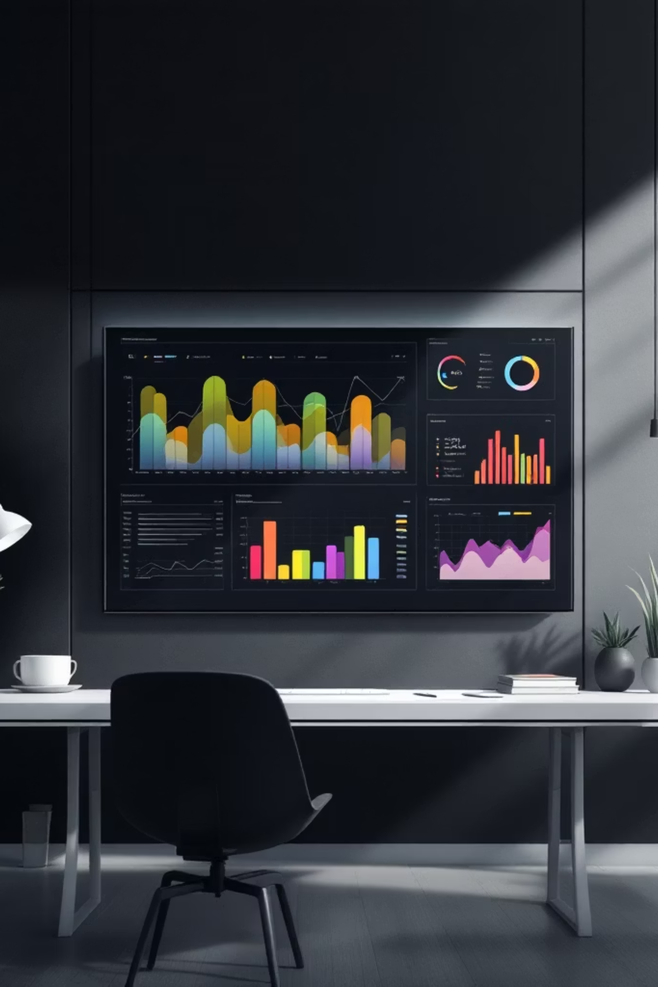
Data-Driven Customer Shopping Behavior
Uncovering actionable insights from 3,900 transactions

Slide 2
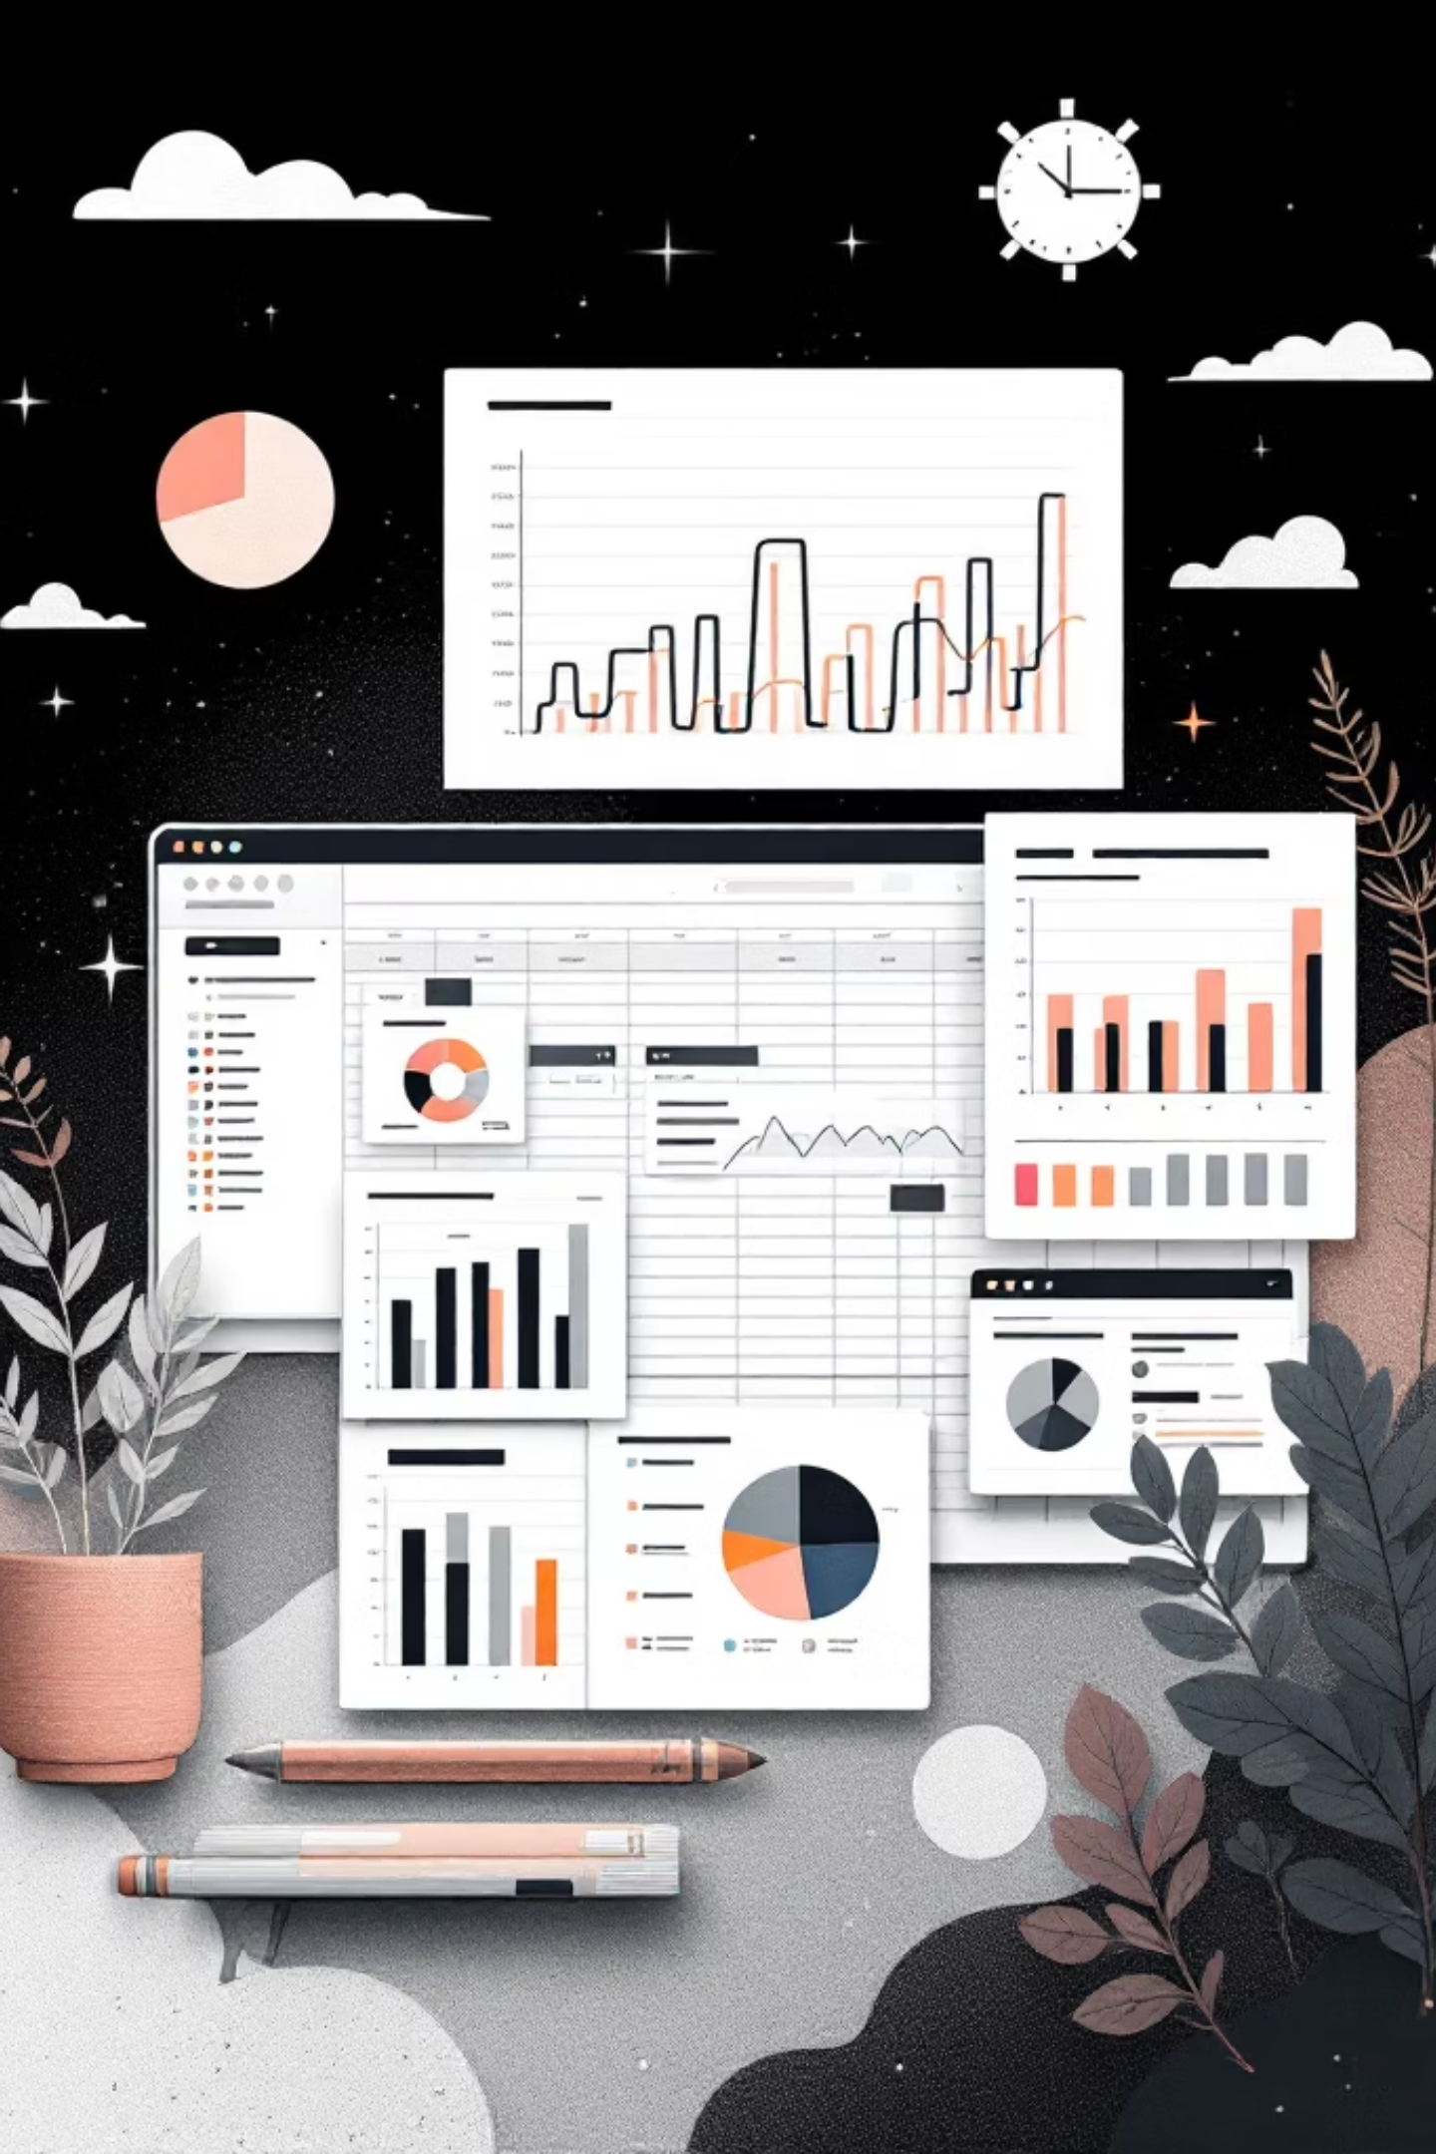
DATASET OVERVIEW
Foundation for Analysis
3,900
18
37
Transactions
Data Points
Missing Values
Comprehensive purchase records analyzed
Customer demographics, purchases, behavior
Review ratings imputed by category median

Slide 3
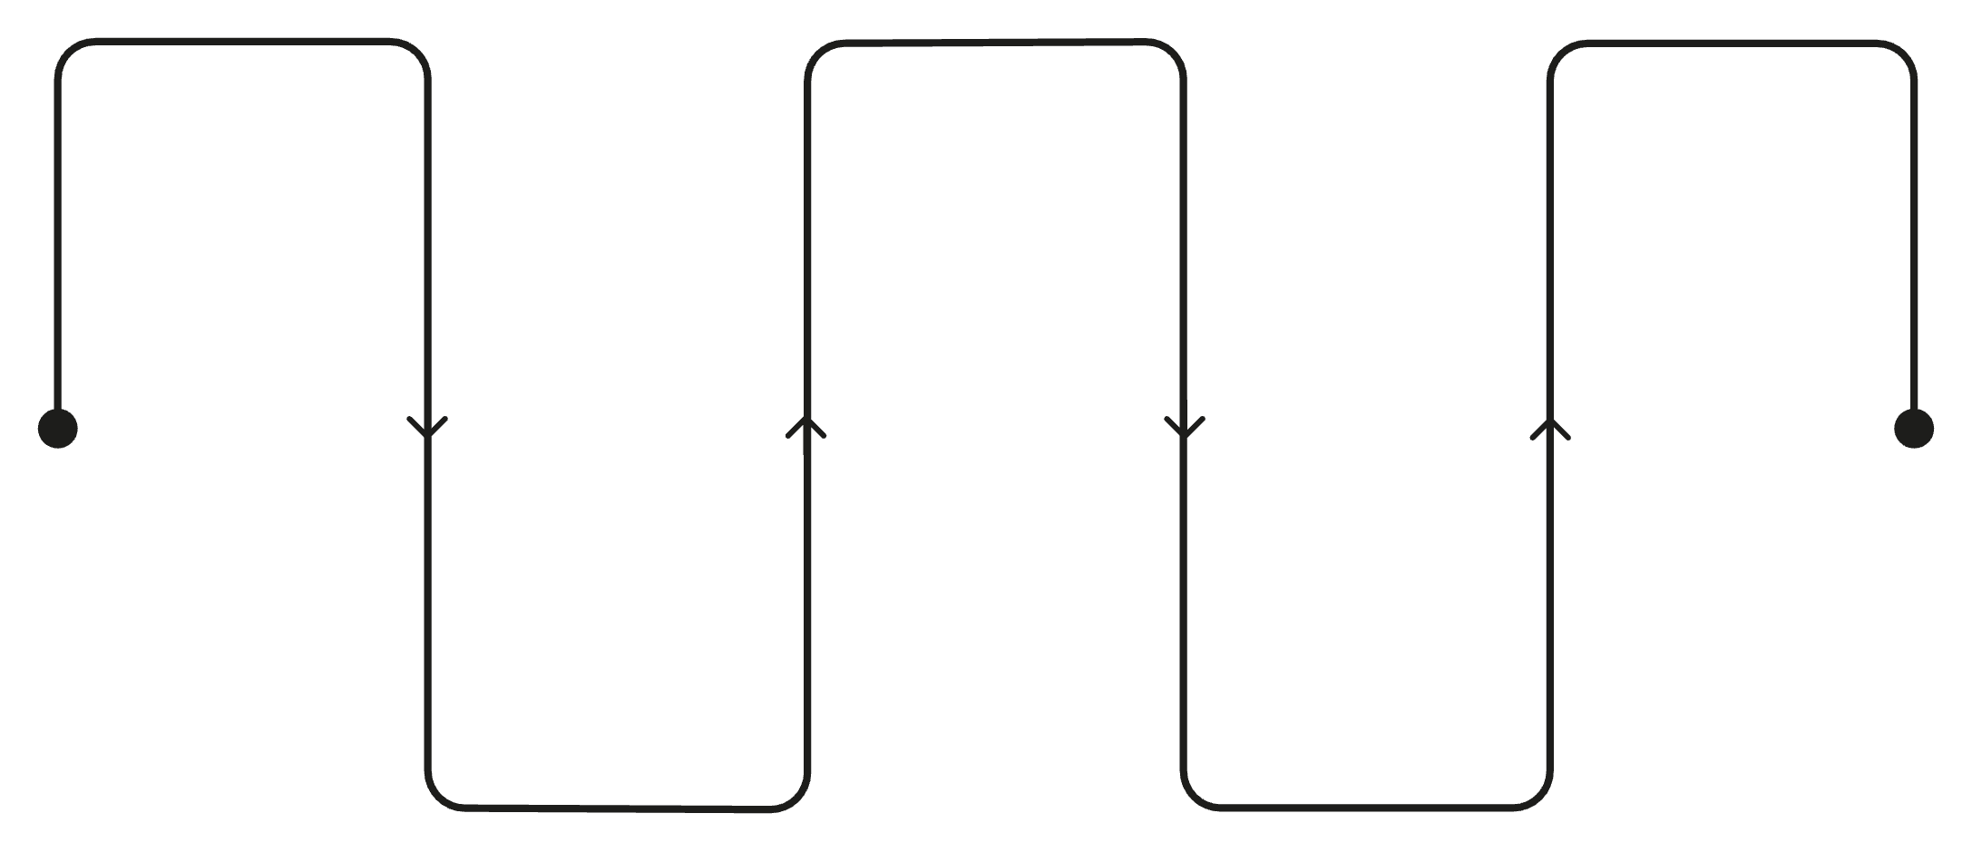
Data Preparation Pipeline
Key Transformations
Load Data
Handle Missing Values
Database Integration
Import raw files and sources
Standardized column naming conventions
Created age groups and purchase frequency metrics
Removed redundant promo code field
Integrated with PostgreSQL for SQL analysis
Push to PostgreSQL for analysis
Impute or remove gaps
Clean & Standardize
Engineer Features
Normalize columns and formats
Create age groups and metrics

Slide 4

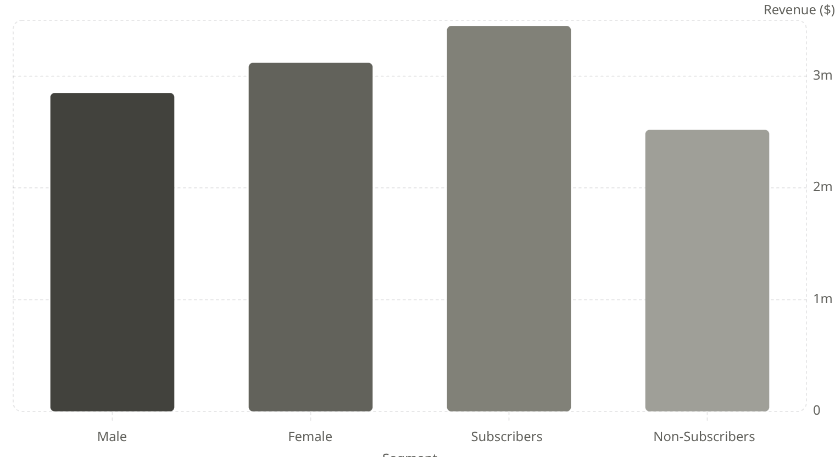
REVENUE INSIGHTS
Gender & Subscription Impact
Key Findings
Female customers generate 9% more revenue than male customers.
Subscribers contribute 37% higher total revenue despite representing smaller customer base.
Opportunity: Expand subscription program to boost lifetime value.

Slide 5

Customer Segmentation Analysis
New Customers
Returning Customers
Loyal Customers
1-2 purchases
3-5 purchases
5+ purchases
Entry point for growth
Building loyalty phase
High subscription rate

Slide 6

Top-Rated Products Drive Value
Highest Average Ratings
Blouse - 4.8 stars
Jewelry - 4.7 stars
Pants - 4.6 stars
Dress - 4.5 stars
Shirt - 4.5 stars
Feature these products prominently in marketing campaigns

Slide 7


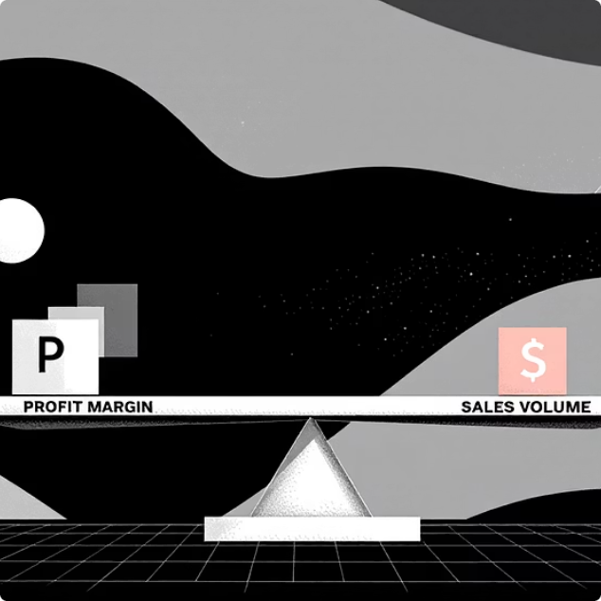
DISCOUNT ANALYSIS
Smart Spenders & Discount Dependency
High-Value Discount Users
Discount-Dependent Products
Margin Control
Customers using discounts while spending above average
Balance promotional sales with profitability goals
Top 5 products with highest discount usage rates

Slide 8
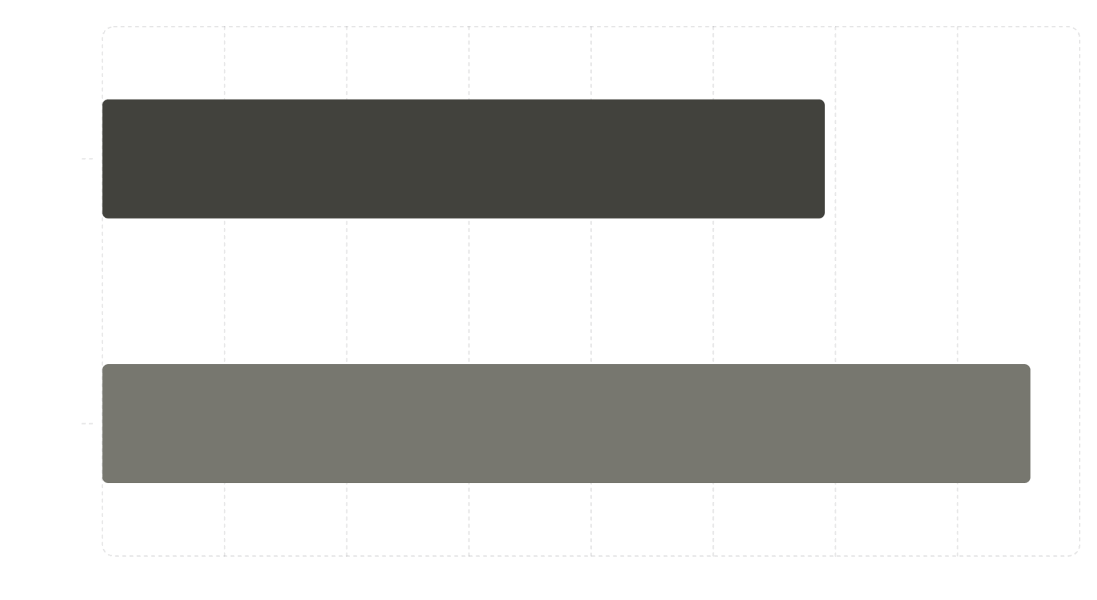
Shipping Preferences & Spending
Purchase Patterns
Express shipping customers demonstrate higher average purchase amounts compared to standard shipping users.
Insight: Premium shipping correlates with premium spending behavior.
Target express shipping users with exclusive offers and high-value product recommendations.

Slide 9
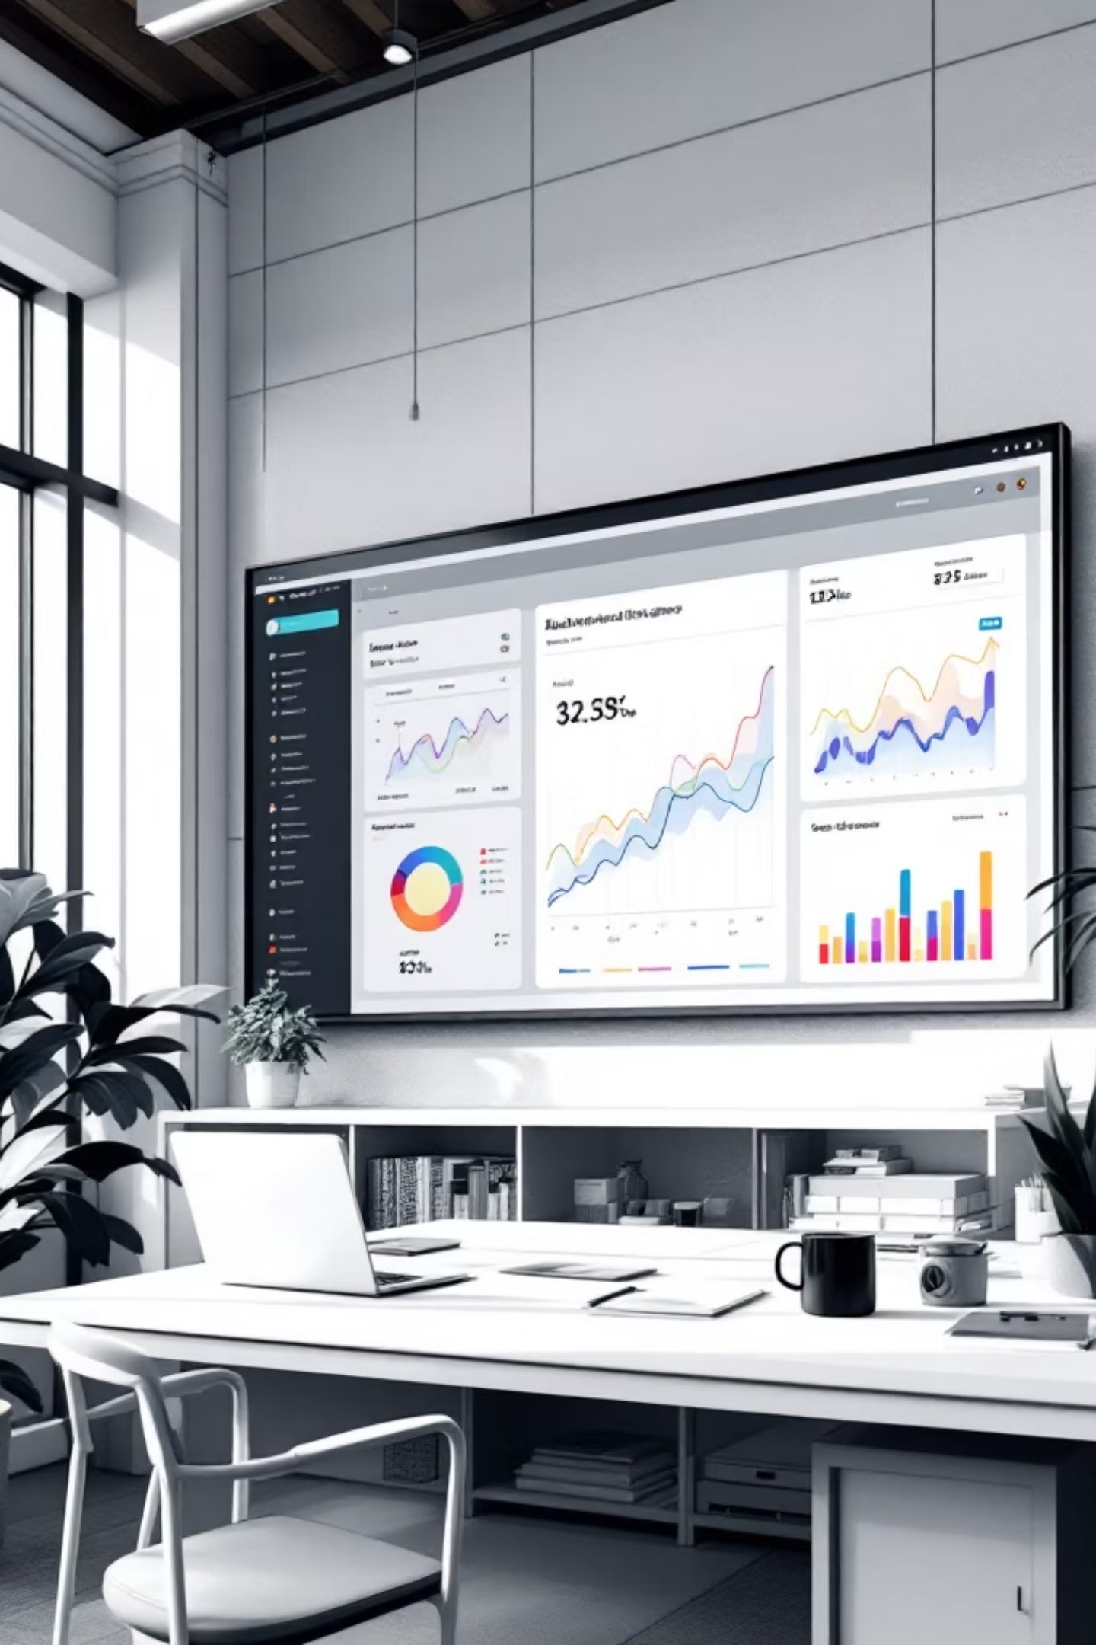
Power BI Dashboard
Comprehensive visual analytics platform integrating all key metrics
Real-Time Insights
Monitor revenue, customer segments, and product performance
Interactive Filtering
Drill down by category, age group, season, and location
Actionable Metrics
Track KPIs and identify growth opportunities instantly

Slide 10




STRATEGIC RECOMMENDATIONS
Next Steps for Growth
Boost Subscriptions
Promote exclusive benefits and rewards
Loyalty Programs
Move returning buyers to loyal segment
Targeted Marketing
Focus on high-revenue age groups

